Slide 1
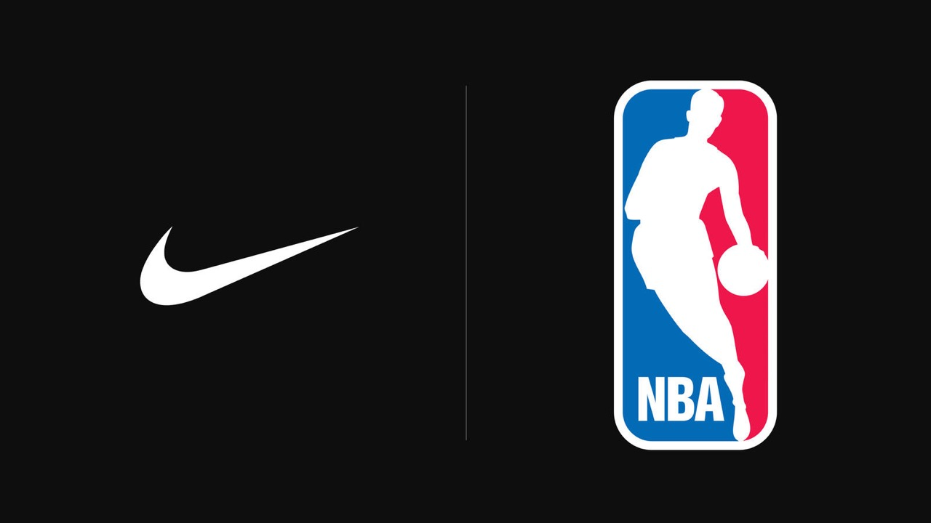

Nike - NBA
Twitter Text Mining Analysis
October 2019 – December 2019
By: Alonso Gallegos
MSBA

Slide 2
Objectives:
•We use the API of all the NBA fan tweets from the period October- December 2019
•The objective of the research is to identify the most related trends, words, or main topics fans discuss each month related to the NBA or Nike
•The main objective of the study is to identify where to allocate extra resources like sponsoring a player, using a social media channel, or doing additional ads on a game to increase the buzz on Nike's presence.

Slide 3
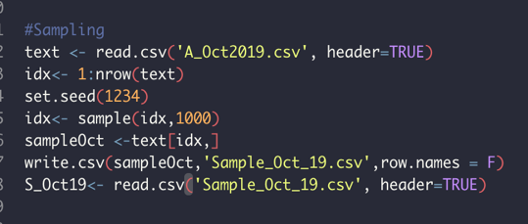
Method and limitations on analysis
The files provided contain more the 45k tweets, which means more than one million characters per month to analyze, which translates into a significant amount of processing power.
To solve the previous limitation on the analysis, we use a simple random sample to get 1000 tweets each month, which can be considered a representative sample.
Since we are using a representative sample, we can make some conclusions of the analysis with a big percentage of certainty

Slide 4
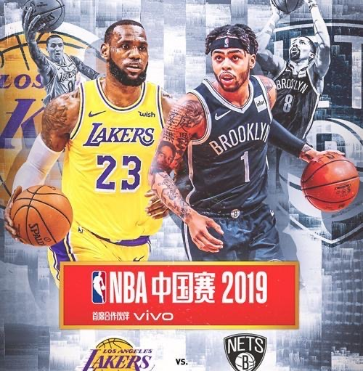
October: Preseason

Slide 5
October: Preseason

Slide 6
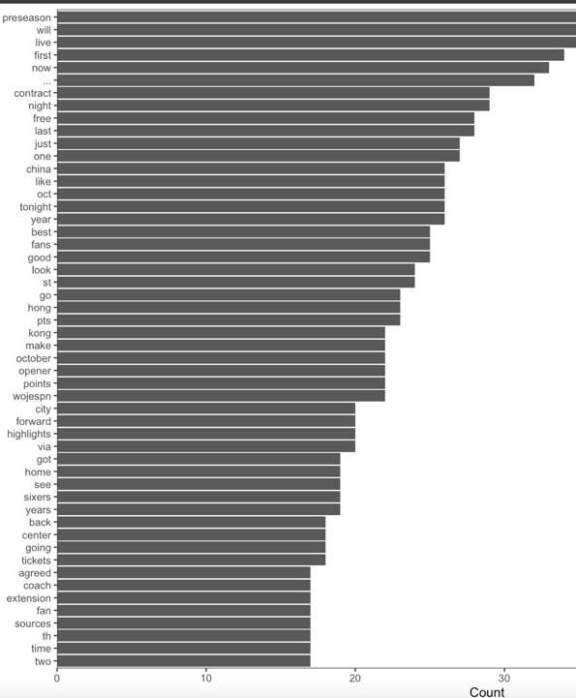
Analyzing the tweets, we notice preseason is the most common word mention this is something expected
We notice two words: Hong Kong and china, something different happen that month: Protest and one NBA manager tweet
We find some commons words also like: game, tickets, espn, live, tonight, which can provide an index of where and where advertise

Slide 7
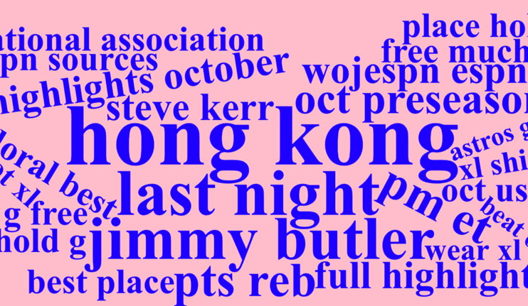
Using a bigram world cloud, we would the following:
Most common player mentioned: Jimmy Butler and Steve Kerr
We find also mentions to the Hong Kong protests
Some common words expected like espn, October or preseason

Slide 8
Player Analysis: Jimmy Butler
We find the association for the the word jimmy:
When doing research, we find out that this was his inaugural game with the Miami Heats against the Hawks
He was the best player on this inaugural game being compared with magic Johnson

Slide 9
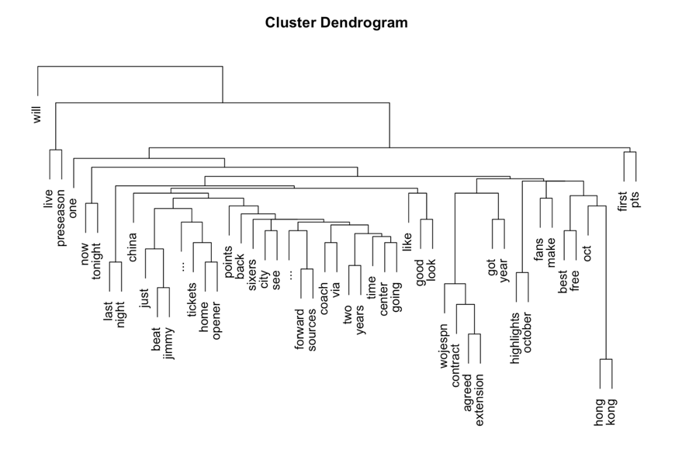

Slide 10
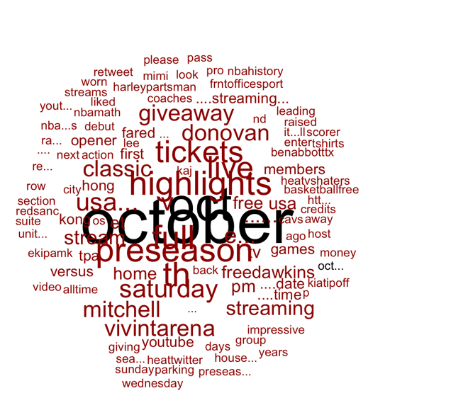
We do a relationship analysis with the word October:
We found some interesting words like Saturday, streaming, opener, Vivint arena.

Slide 11
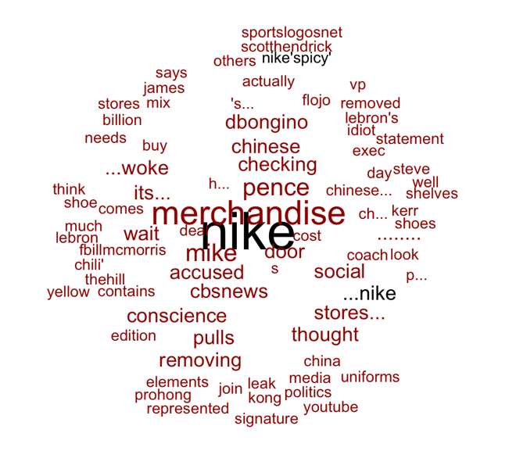
We do a relationship analysis with the word nike:
We found some interesting words like merchandise, Chinese, stores, shoe, lebron.

Slide 12
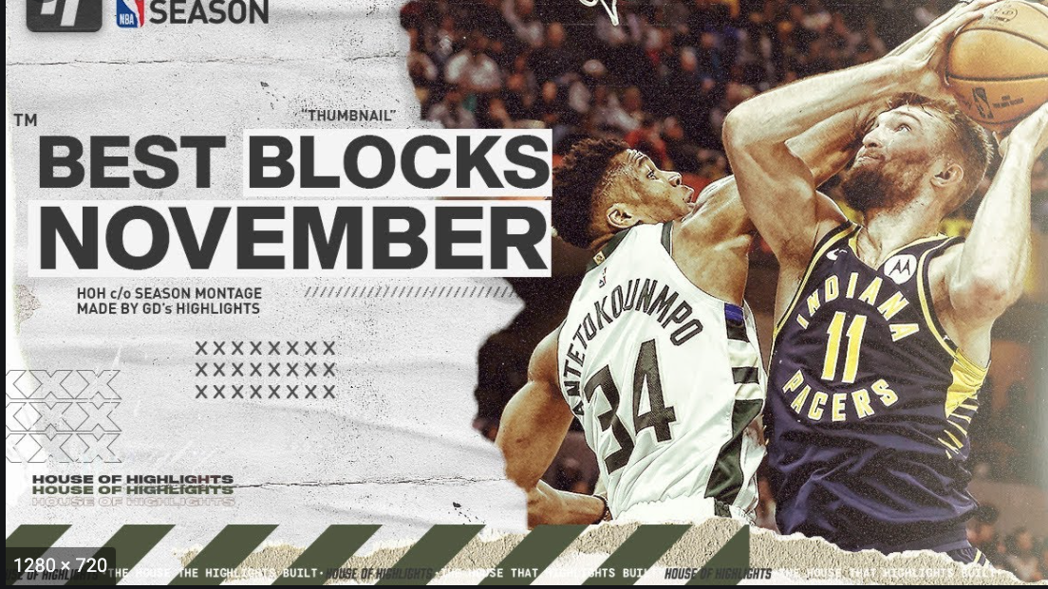
November
Games, Lebron, Lakers

Slide 13
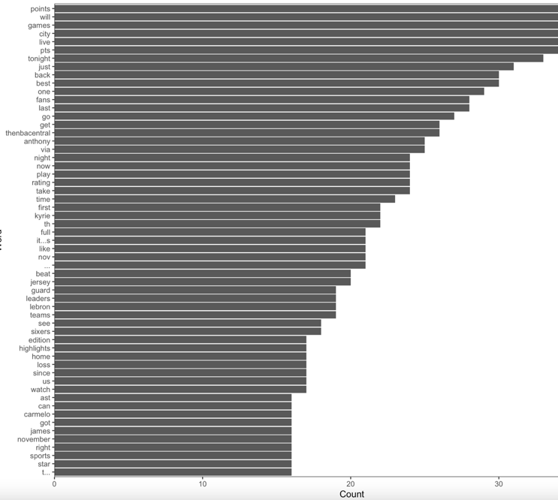
Analyzing the tweets, we notice games, points, blocks are the most common word mention this is something expected
We notice also some players names like lebron, antohny,

Slide 14
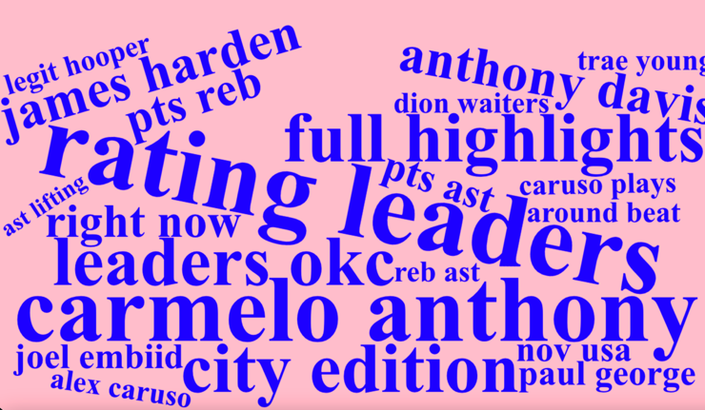
Antony Carmelo is the most mention player
It was his inaugural game with the Portland Trail blazer against the pelicans

Slide 15
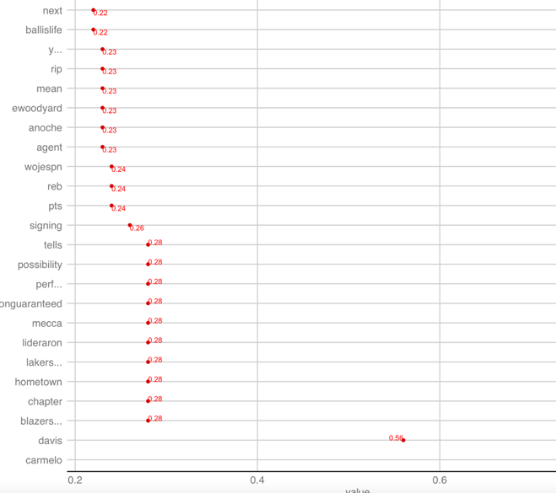
Player Analysis: Anthony Carmelo
We find the association for the the word Anthony Carmelo:
The word Davis appears a lot since he was the main player on the New Orleans pelicans
Also signing since he just sign for the Blazers

Slide 16
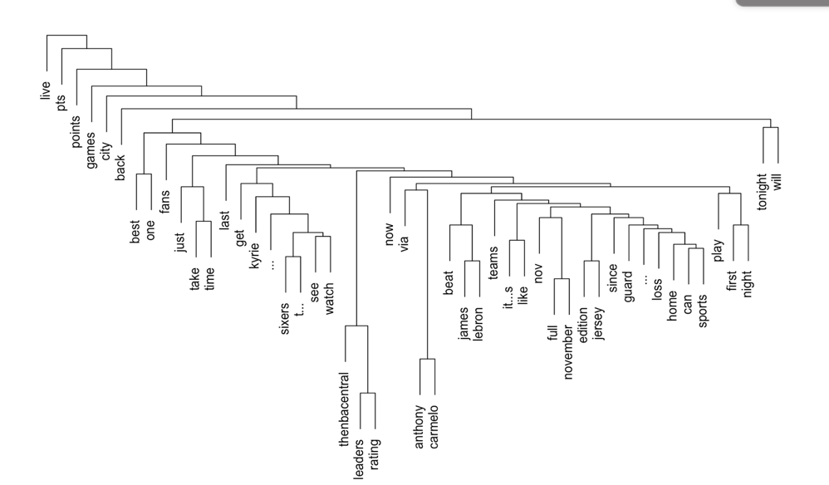
Cluster Dendrogram

Slide 17
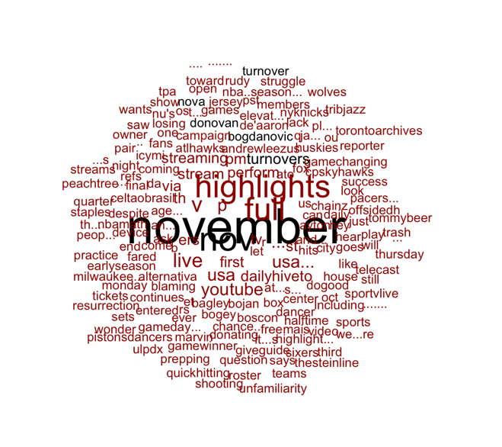
We do a relationship analysis with the word November:
We found some interesting words like usa, YouTube, live, pacers, sportstvlive.

Slide 18
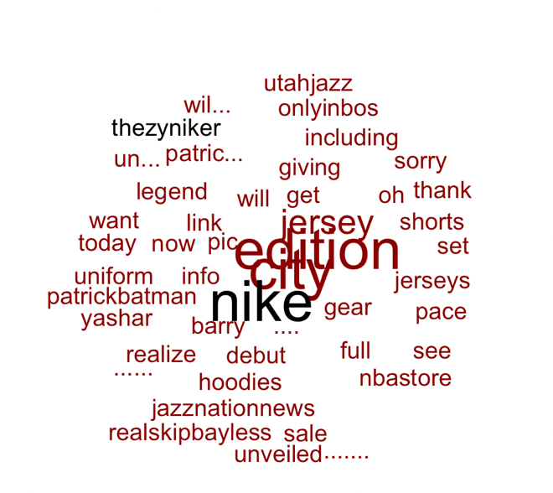
We do a relationship analysis with the word Nike:
We found some interesting words like jersey,edition, city, hoodies, nbastore

Slide 19
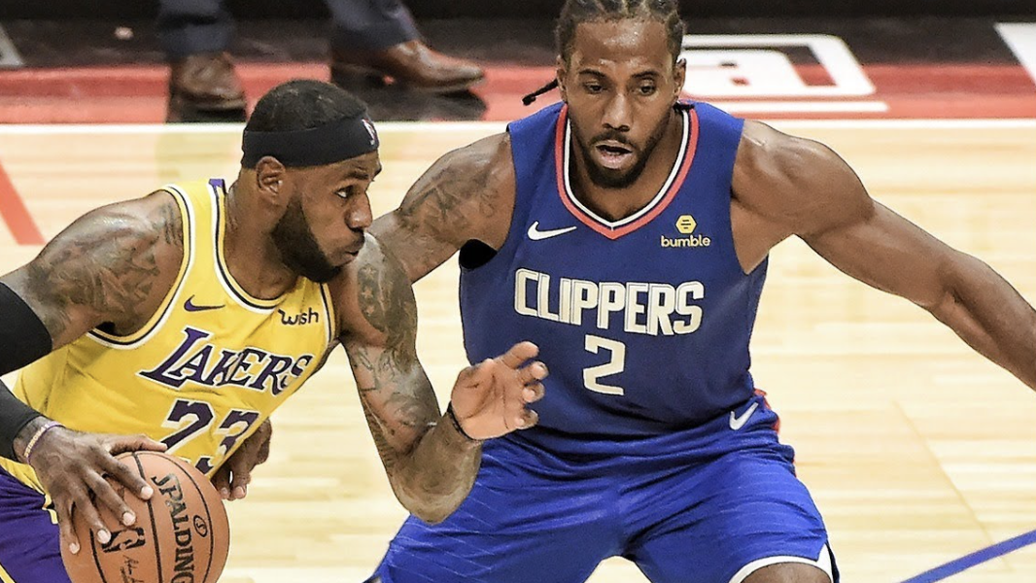
December
Lebron, Chrismas, Kwahi

Slide 20
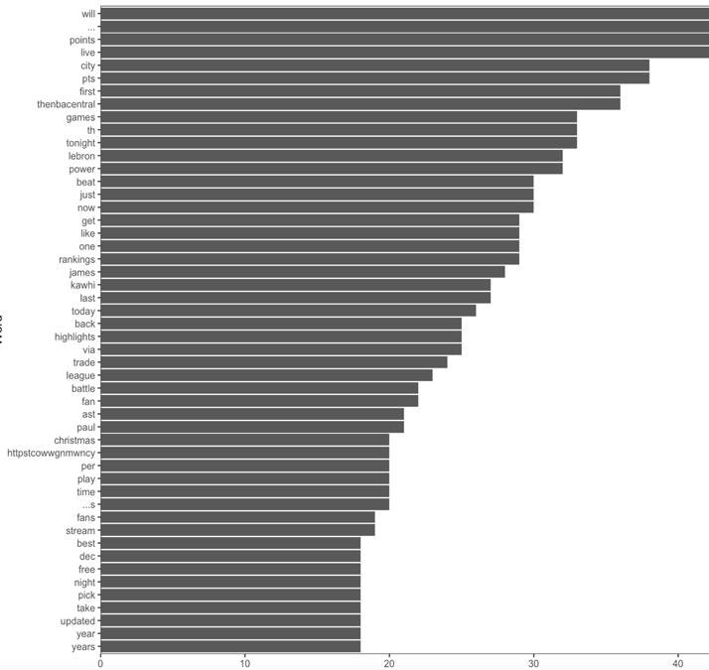
Analyzing the tweets, we notice games, points, blocks are the most common word mention this is something expected
We notice also some players names like lebron, kawhi
An finally because of the season the word Christmas for the Christmas games

Slide 21
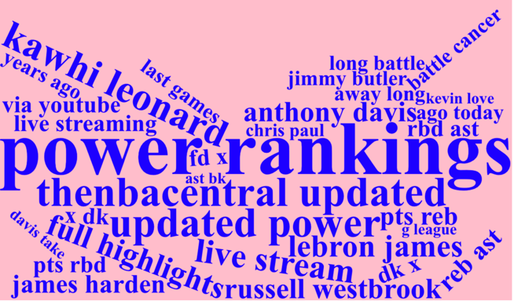
Kawhi Leonard is the most mention player and also power ranking since it is the end of the year
The Christmas games against the lakers(Lebron) was the most commented on the month

Slide 22
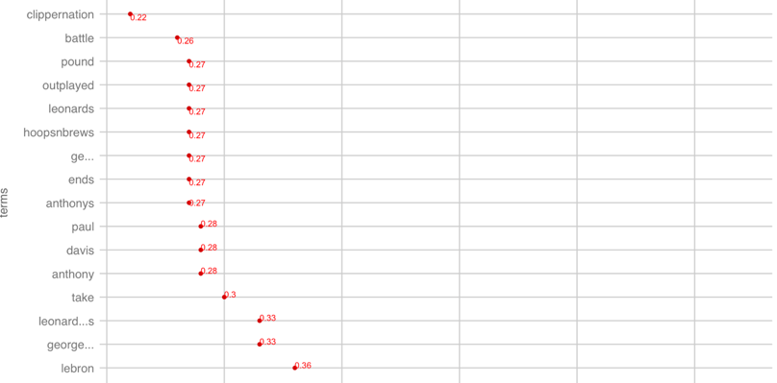
Player Analysis: Kawhi Leonard
The game against on Christmas the lakers is the most mentioned trend on the month
Clipper related words and lebron are highly related to Kwahi

Slide 23
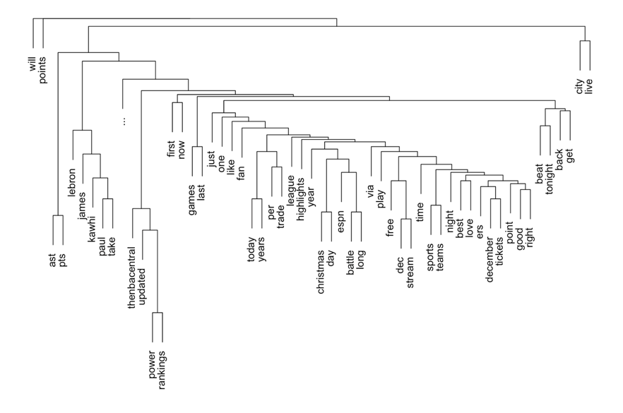

Slide 24
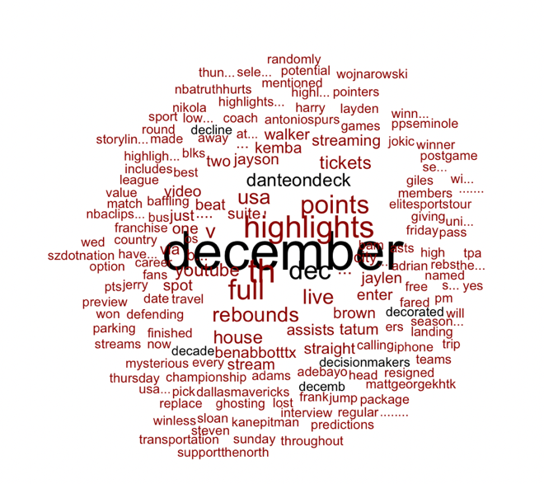
We do a relationship analysis with the word December:
We found some interesting words like tickets, stream, youtube, and some other players like brown, jaylen.

Slide 25
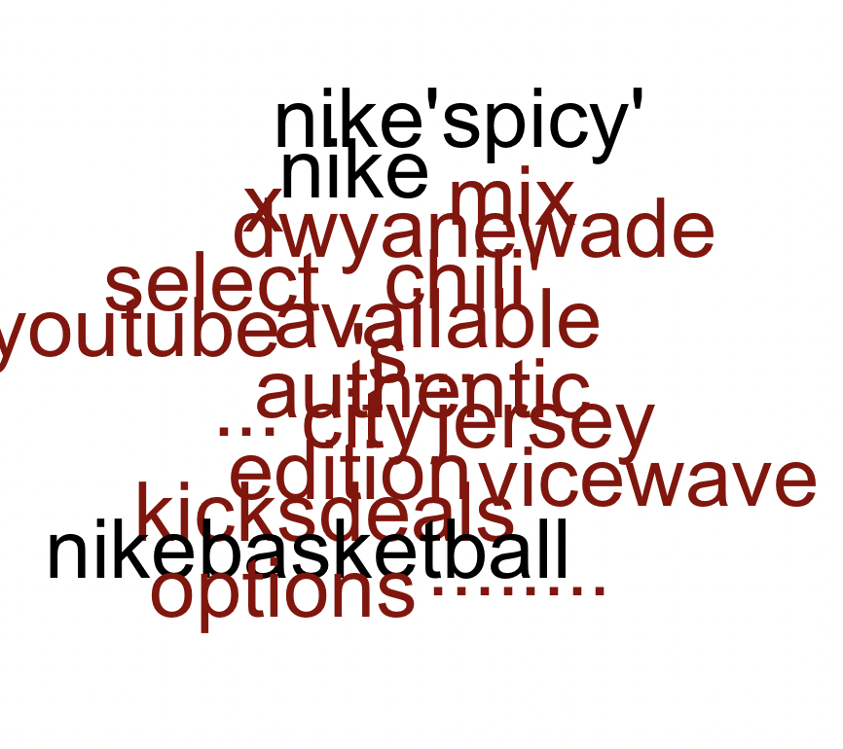
We do a relationship analysis with the word Nike:
We found some interesting words like vicewave, Dwayne wade, chili, edition

Slide 26

Common words and Comparison

Slide 27
Common Words Oct19-Dec19

Slide 28
Comparison Words Oct19-Dec19

Slide 29
Conclusions
•To allocate resources, my recommendation is to increase advertising on live broadcasting platforms like ESPN, Hulu, or youtube; these trends can be found on most every month analyze
•The launch of edition jerseys; for example, in December for Miami heats player Dwayne Wade makes a lot of buzz on the fans, making it a trend. Also, the word jerseys appear almost every month. This kind of advertising is useful since it is one of the leading products of Nike.
•Sponsors players when changing teams, there is always great expectation on the performance of new players on their inaugural team, which can bring a lot of publicity to the brand
•Focus on big games related to main events like the lakers' Christmas game against the clippers, which capture the trends.

